Slide 1
Corporate Presentation
June 2018

Slide 2



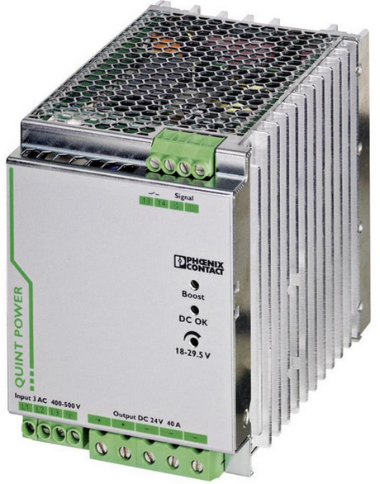


Current SiC Application Areas
Server & Datacenter
Lighting & Electronic Ballast
Electronic Vehicles
Lab & Din Rail PSU
Battery Charging
Renewable Energy & Storage

Slide 3

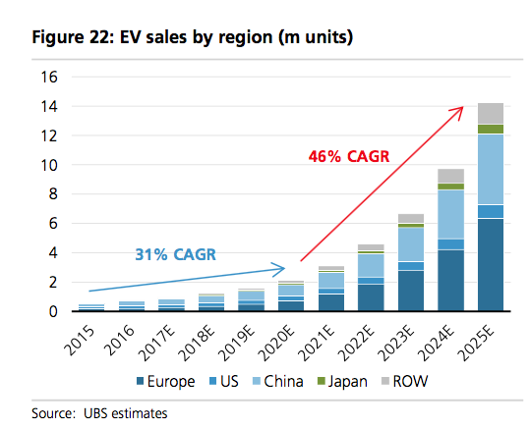
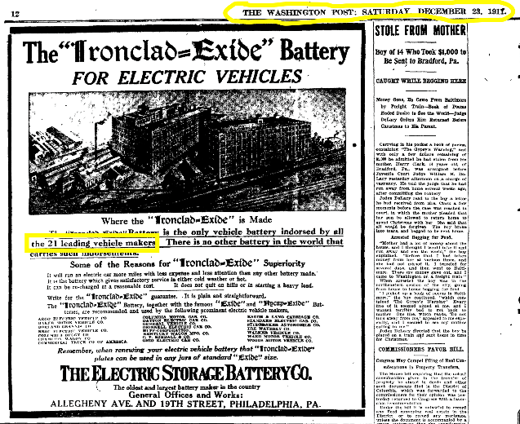
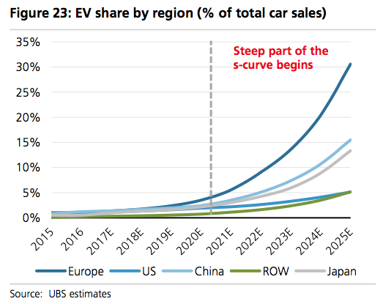
SiC is at a Tipping Point . . . Electric Vehicle Adoption is a major driver
EV Battery Ad from 1911

Slide 4
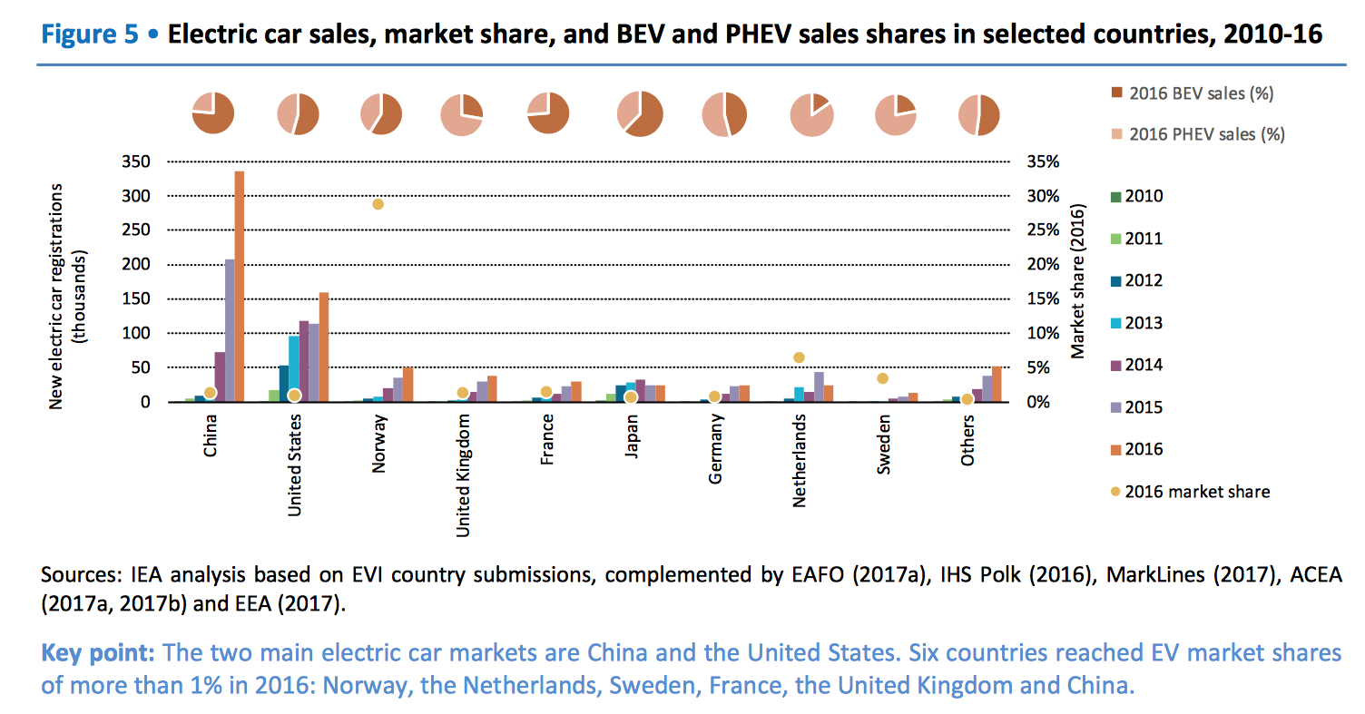
Global EV Sales By Country
EV History and promise
In 2017, China sold 578,000 electric passenger vehicles – 4X that of the US

Slide 5
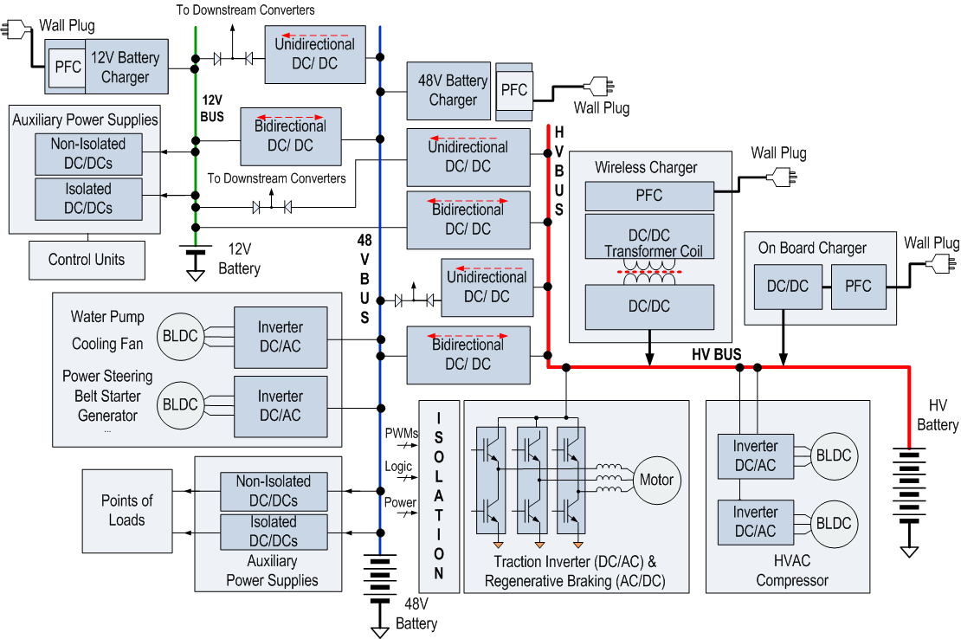
UnitedSiC Electric Vehicle Activity
Areas of UnitedSiC
Shipments
Note: Adapted from TI

Slide 6
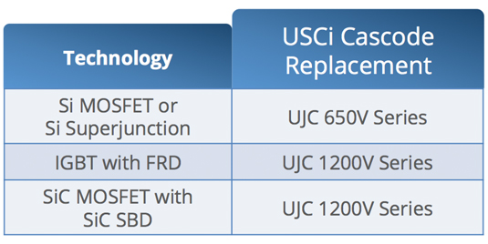

UJC Series Ease of Use
Replace IGBTs, SiC MOSFETs or Si Superjunction devices with no change to gate drive voltages

Slide 7

UnitedSiC FETs Compared to SiC MOSFETs
Normally Off
USCi Cascode
Normally Off
Typical SiC MOSFET
Integrated LV
Si-MOSFET
Additional Antiparallel SiC Diode
Die Size | (Smaller) R_{DSA}~ 1.75mΩ-cm² | (Larger) R_{DSA}~ 3.1- 4.5 mΩ-cm²
Gate Drive | (Standard) V_{GS} = 0V to 12V OR (SIC) V_{GS} = -10V to 20V | V_{GS} = -5V to 20V
Threshold | V_{GS(TH)} = 5V Typical | V_{GS(TH)} = 2.2V Typical
Intrinsic Diode | Low Qrr, +10% Over Temperature | High Qrr, High VF 3X Over Temperature
Avalanche | Yes | Yes
Short Circuit | Yes | Low

Slide 8
SiC Cascode Gate Drive Benefit
25
V
19
V
22
V
20
V
Si IGBT
SiC Cascode
SiC MOSFET
SiC MOSFET
18
V
/
0
V
15
V
/
0
V
12
V
/
0
V
15
V
/
-
4
V
0
V
-
6
V
-
8
V
-
20
V
Notes: Maximum VGS rating vs. recommended VGS.
SiC MOSFET can be operated at Vgs=0V in some circuits
-25
V
Easy Drop-in
12V turn-on makes SiC cascode an easy choice for drop-in replacement.
Extra Margin in VGS
SiC cascode has higher margin in VGS design and requires no negative VGS for turn-off.

Slide 9
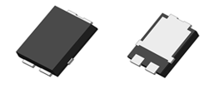
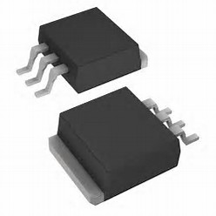
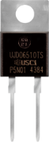
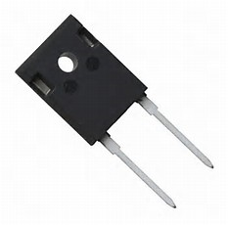
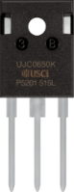
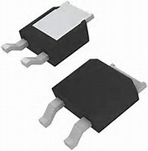
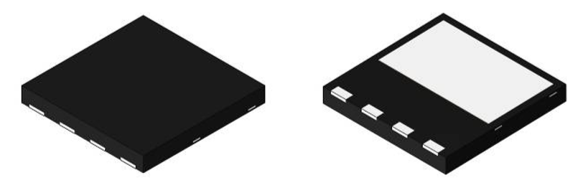
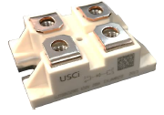
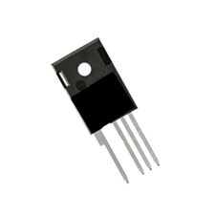
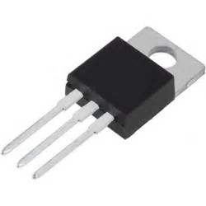
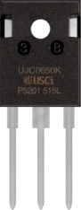

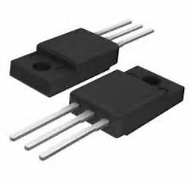
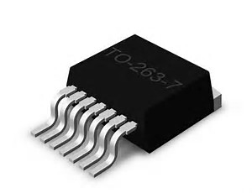
Discrete Packages for SiC
Diodes
Transistors
Largely similar to Si offerings, making them easier to incorporate
Source Kelvin packages
TO247-4L, D2PAK-7L reduces gate ringing, allows faster di/dt operation
Lower inductance DFN8X8 <1.5nH suitable for 650V

Slide 10
4 inch SiC JBS Diode Portfolio
Family | Base PN | Description | Samples | RTM | Die | T0-220 | TO-247 | SOT227
650V JBS | UJD06504Z/TS | 650V/4A JBS | Available | Available | MP | MP
650V JBS | UJD06506Z/TS | 650V/6A JBS | Available | Available | MP | MP
650V JBS | UJD06508Z/TS | 650V/8A JBS | Available | Available | MP | MP
650V JBS | UJD06510Z/TS | 650V/10A JBS | Available | Available | MP | MP
650V JBS | UJD06516K | 650V/16A JBS | Available | Available |  |  | MP
650V JBS | UJD06520K | 650V/20A JBS | Available | Available |  |  | MP
650V JBS | UJD06550Z | 650V/50A JBS | Available | NA | ES
650V JBS | UJD065100Z | 650V/100A JBS | Available | NA | ES
1200V JBS | UJ2D1205T | 1200V/5A JBS G2 | Available | Available | MP | MP
1200V JBS | UJ2D1210T | 1200V/10A JBS G2 | Available | Available | MP | MP
1200V JBS | UJ2D1215T | 1200V/15A JBS G2 | Available | Available | MP | MP
1200V JBS | UJ2D1220K | 1200V/20A JBS G2 | Available | Available |  |  | MP
1200V JBS | UJ2D1230K | 1200V/30A JBS G2 | Available | Available |  |  | MP
1200V JBS | UJ2D1250Z | 1200V/50A JBS G2 | Available | Available | ES |  | NA | NA
MP: Mass Production ES: Engineering samples available D: in Development

Slide 11
6 inch 650V G3 SiC Diodes
Family | Part number | Description | Samples | Production | Die | Package
650V | UJ3D065200 | 200A 650V JBS diode Die | Available | 2H 2018 | 200A | Wafer
650V | UJ3D065200S | 200A 650V JBS Diode SOT227 | 1H 2018 | 2H 2018 | 200A | SOT227
650V | UJ3D06530TS | 30A 650V JBS diode | Available | MP | MP | TO220-2L
650V | UJ3D06560KS | 2X 30A 650V JBS diode | Available | MP | 30A dual | TO247-3L
650V | UJ3D06516TS | 16A 650V JBS Diode | Available | MP | NA | TO220-2L
650V | UJ3D06512TS | 12A 650V JBS Diode | Q2 18 | Q2 18 | NA | TO220-2L
650V | UJ3D06520TS | 20A 650V JBS Diode | Available | MP | NA | TO220-2L
650V | UJ3D06520KSD | 10A 650V JBS Diode, Common cathode dual | Available | MP | 10A dual | TO247-3L
650V | UJ3D06510 | 10A 650V JBS Diode | Available | MP | 10A | Wafer
650V | UJ3D06510TS | 10A 650V JBS Diode | Available | MP | 10A | TO220-2L
650V | UJ3D06508 | 8A 650V JBS Diode | Available | MP | 8A | Wafer
650V | UJ3D06508TS | 8A 650V JBS Diode | Available | MP | 8A | TO220-2L
650V | UJ3D06506 | 6A 650V JBS Diode | Q2 18 | Q2 18 | 6A | Wafer
650V | UJ3D06506TS | 6A 650V JBS Diode | Q2 18 | Q218 | 6A | TO220-2L
650V | UJ3D06504 | 4A 650V JBS Diode | Available | MP | 4A | Wafer
650V | UJ3D06504TS | 4A 650V JBS Diode | Available | MP | 4A | TO220-2L

Slide 12
6 inch 1200V G3 SiC Diodes
Family | PN | Description | Samples | Production | Die | Package
1200V | UJ3D12100 | 100A 1200V JBS diode | Available | Q4 2018 | 100A
1200V | UJ3D12100S | 100A 1200V JBS diode | Q2 2018 | Q4 2018 | 100A | SOT227
1200V | UJ3D1250 | 50A 1200V JBS diode | Available | Now | 50A
1200V | UJ3D1250K | 50A 1200V JBS diode | Available | Now | 50A | TO247-3L
1200V | UJ3D12100SD | 2X 50 1200V JBS diode Dual | Q2 2018 | Q4 2018 | 50A | SOT227
1200V | UJ3D1220KSD | 2X 10A 1200V JBS diode common cathode dual | Available | Now | 10A | TO247-3L
1200V | UJ3D1210KSD | 2X 5A 1200V JBS diode common cathode dual | Available | Now | 5A | TO247-3L
1200V | UJ3D1210 | 10A 1200V JBS diode | Available | Now | 10A | ES
1200V | UJ3D1210TS | 10A 1200V JBS diode | Available | Now | 10A | TO220-2L
1200V | UJ3D1205 | 5A 1200V JBS diode | Available | Now | 5A
1200V | UJ3D1205TS | 5A 1200V JBS diode | Available | Now | 5A | TO220-2L
1200V | UJ3D1202 | 2A 1200V JBS diode | Available | Now | 2A | ES
1200V | UJ3D1202TS | 2A 1200V JBS diode | Available | Now | 2A | TO220-2L

Slide 13
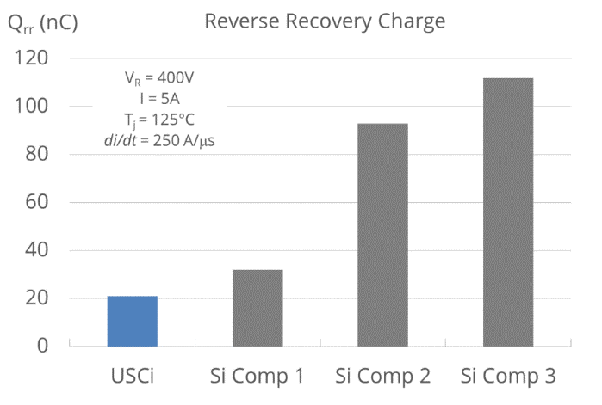
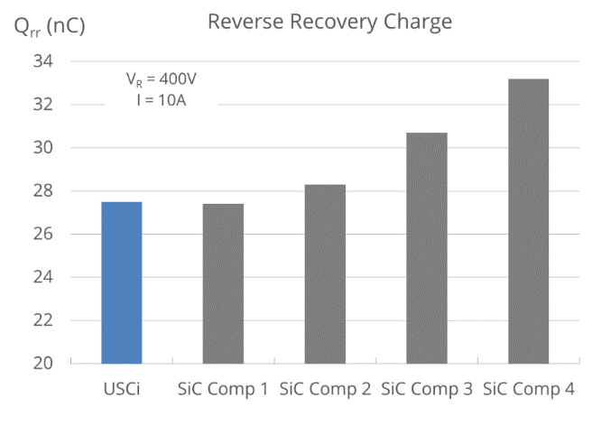
SiC Diode Differentiator: Q_{C}
Best-in-class performance
USCi matched with industry leading die sizes (cost)
Leading the way to foundry based 6inch transition – AEC-Q101 Qualified

Slide 14
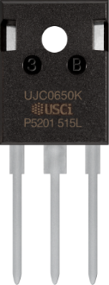
4 inch 2nd Generation UnitedSiC FETs
Family | Base PN | Description | Samples | Production | Die | TO247-3L
1200V Cascode | UJC1206K | 1200V 60mΩ SiC Cascode | Available | RTM | NA | MP
1200V Cascode | UJC1210K | 1200V 100mΩ SiC Cascode | Available | RTM | NA | MP
650V Cascode | UJC06505K | 650V 45mΩ SiC Cascode | Available | RTM | NA | MP
MP: Mass Production ES: Engineering samples available D: in Development

Slide 15
6 inch 3rd Generation SiC JFETs
Family | Part Number | Description | Samples | Production | Die | package
1700V JFET | UJ3N170006 | 1700V 5.6mΩ SiC JFET N-on | Now | TBD |  | Die for SuperCas
1700V JFET | UJ3N170600 | 1700V 600mΩ SiC JFET N-on | Done |  |  | Current limiter
1700V JFET | UJ3N170580 | 1700V 580mΩ SiC JFET N-on | Q2 18 | Q3 18 |  | Die
1700V JFET | UJ3N170580K3S | 1700V 580mΩ SiC JFET N-on | Q2 18 | Q3 18 |  | TO247-3L
1700V JFET | UJ3N170580B7 | 1700V 580mΩ SiC JFET N-on | Q2 18 | Q3 18 |  | D2PAK-7L
1700V JFET | UJ3N1701K6 | 1700V 1.6Ω SiC JFET N-on | Now | TBD |  | Die
1200V JFET | UJ3N120008 | 1200V 7.5mΩ SiC JFET N-on | Q2 18 | Q3 18 |  | Die/ SOT227
1200V JFET | UJ3N120035K3S | 1200V 35mΩ SiC JFET N-on | Q1 18 | Q2 18 |  | TO247-3L
1200V JFET | UJ3N120070K3S | 1200V 70mΩ SiC JFET N-on | Q1 18 | Q2 18 |  | TO247-3L
1200V JFET | UJ3N120140K3S | 1200V 140mΩ SiC JFET N-on | Q2 18 | Q2 18 |  | TO247-3L
650V JFET | UJ3N065005 | 650V 5.3mΩ SiC JFET N-on | Q2 18 | Q3 18 |  | Die, SOT227
650V JFET | UJ3N065025K3S | 650V 25mΩ SiC JFET N-on | Q1 18 | Q2 18 |  | TO247-3L
650V JFET | UJ3N065070K3S | 650V 70mΩ SiC JFET N-on | Q1 18 | Q2 18 |  | TO247-3L
650V JFET | UJ3N065035K3S | 650V 35mΩ SiC JFET N-on | Q2 18 | Q2 18 |  | TO247-3L

Slide 16
6 inch 3rd Generation SiC FETs
Family | PN | Description | Samples | Production | Die | Package
1200V Cascode | UJ3C120150K3S | 1200V 150mΩ SiC Cascode | 18-Mar | Q2 18 |  | TO247-3L
1200V Cascode | UJ3C120080K3S | 1200V 80mΩ SiC Cascode | Now | Q1 18 |  | TO247-3L
1200V Cascode | UJ3C120040K3S | 1200V 40mΩ SiC Cascode | Now | Q1 18 |  | TO247-3L
650V Cascode | UJ3C065080K3S | 650V 80mΩ SiC Cascode | Now | Q1 18 |  | TO247-3L
650V Cascode | UJ3C065030K3S | 650V 30mΩ SiC Cascode | Now | Q1 18 |  | TO247-3L
650V Cascode | UJ3C065080T3S | 650V 80mΩ SiC Cascode | Now | Q1 18 |  | TO220-3L
650V Cascode | UJ3C065030T3S | 650V 30mΩ SiC Cascode | Now | Q1 18 |  | TO220-3L
650V Cascode | UJ3C065080B3S | 650V 80mΩ SiC Cascode | Now | Q1 18 |  | D2PAK-3L
650V Cascode | UJ3C065030B3S | 650V 30mΩ SiC Cascode | Now | Q1 18 |  | D2PAK-3L
650V Cascode | UJ3CF065040K3S | 650V 40mΩ SiC Cascode Fast | Mar-18 | Q2 18 |  | TO247-3L
650V Cascode | UJ3CF065040T3S | 650V 40mΩ SiC Cascode Fast | Mar-18 | Q2 18 |  | TO220-3L
650V Cascode | UJ3CF065040K4S | 650V 40mΩ SiC Cascode Fast | Mar-18 | Q2 18 |  | TO247-4L
650V Cascode | UJ3CF065030K4S | 650V 30mΩ SiC Cascode Fast | Jan-18 | Q2 18 |  | TO247-4L
650V Cascode | UJ3CF065080K4S | 650V 80mΩ SiC Cascode Fast | Jan-18 | Q2 18 |  | TO247-4L
1200V Cascode | UJ3CF120150K4S | 1200V 150mΩ SiC Cascode Fast | 18-Apr | Q2 18 |  | TO247-4L
1200V Cascode | UJ3CF120080K4S | 1200V 80mΩ SiC Cascode Fast | 18-Jan | Q2 18 |  | TO247-4L
1200V Cascode | UJ3CF120040K4S | 1200V 40mΩ SiC Cascode Fast | 18-Jan | Q2 18 |  | TO247-4L
650V Cascode | UJ3SCF065040K4S | 650V Stack 40mΩ SiC Cascode Fast | 2H 2018 | 2H 2018 |  | D2PAK-7L
650V Cascode | UJ3SCF065030K4S | 650V Stack 30mΩ SiC Cascode Fast | 2H 2018 | 2H 2018 |  | D2PAK-7L
650V Cascode | UJ3CF065080K4S | 650V 80mΩ SiC Cascode Fast | 2H 2018 | 2H 2018 |  | D2PAK-7L
1200V Cascode | UJ3CF120150K4S | 1200V 150mΩ SiC Cascode Fast | 2H 2018 | 2H 2018 |  | D2PAK-7L
1200V Cascode | UJ3CF120080K4S | 1200V 80mΩ SiC Cascode Fast | 2H 2018 | 2H 2018 |  | D2PAK-7L
1200V Cascode | UJ3SCF120040K4S | 1200V Stack 40mΩ SiC Cascode Fast | 2H 2018 | 2H 2018 |  | D2PAK-7L
650V Cascode | UJ3SCF065040K4S | 650V Stack 40mΩ SiC Cascode Fast | 2H 2018 | 2H 2018 |  | DFN8X8
650V Cascode | UJ3SCF065030K4S | 650V Stack 30mΩ SiC Cascode Fast | 2H 2018 | 2H 2018 |  | DFN8X8
650V Cascode | UJ3SCF065080K4S | 650V Stack 80mΩ SiC Cascode Fast | 2H 2018 | 2H 2018 |  | DFN8X8

Slide 17
Gen 3 FETs vs Current Products
T_{JMAX} rating raised to 175 ºC
V_{GSMAX} rating raised to +/- 25V
Built-in ESD protection diodes between MOSFET gate-source
Compatible with all forms of standard Si and SiC gate drive voltages, with plenty of positive and negative voltage margin
Current rating increased by reducing R_{THJC} (same die size, improved die attach technology)
Rdson at 150 ºC improved compared to G2
No change to UIS rating, able to handle high peak currents in avalanche
Switching losses decrease with Tj, due to the reduction of JFET Rg with temperature
Similar switching speed in turn-on/turn-off using SiC JBS freewheeling diode

Slide 18
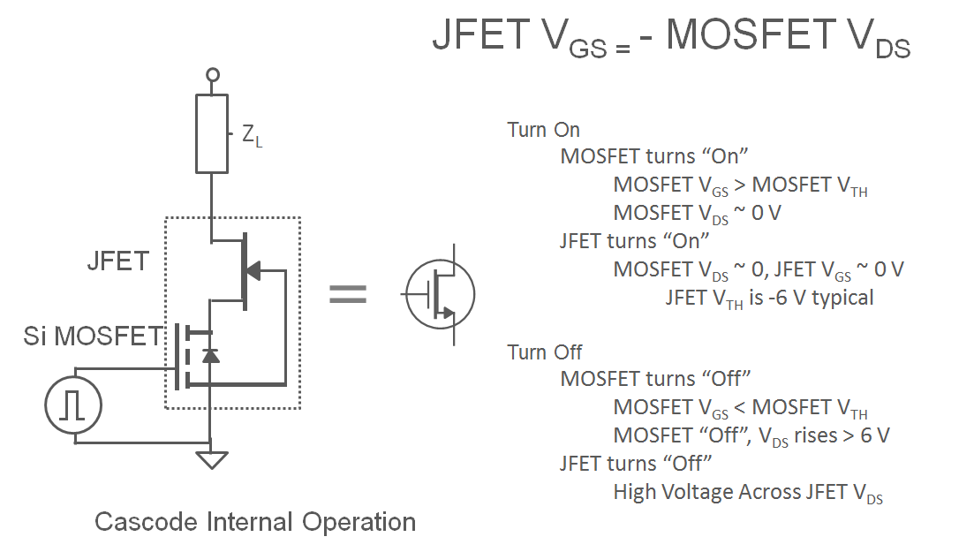
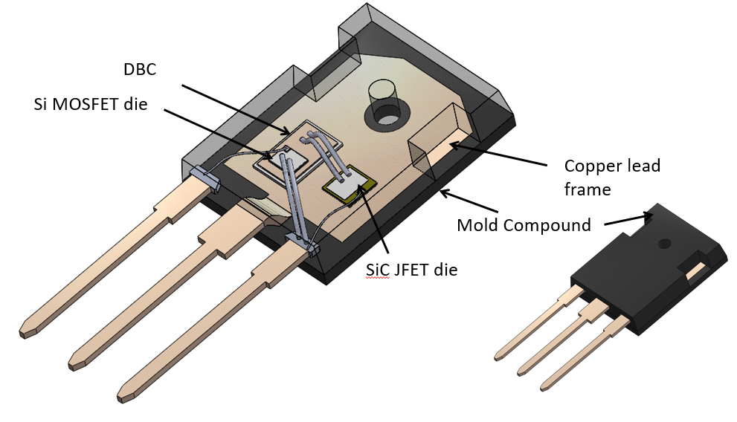
Cascode Operation

Slide 19
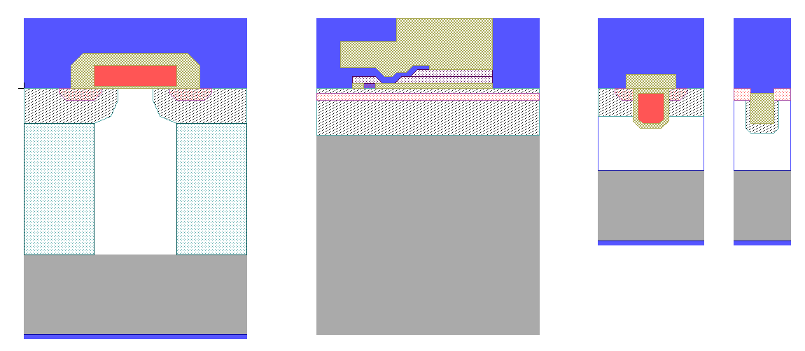
650V – FET Technologies Compared
Source
Source
Drain
Source
Source
P-col
N-col
substrate
substrate
substrate
Drain
Drain
substrate
Trench MOS
Trench JFET
Drain
Silicon Superjunction
Vertical current flow
GaN HEMT
Lateral current flow
SiC
Vertical current flow

Slide 20
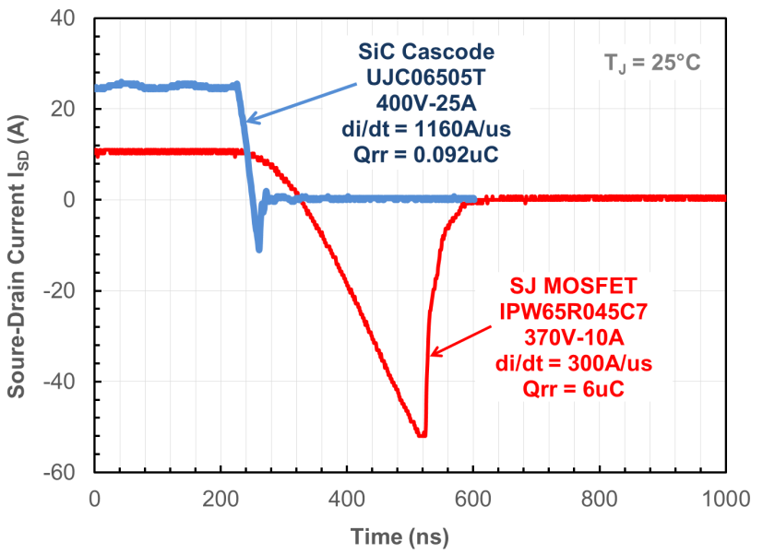
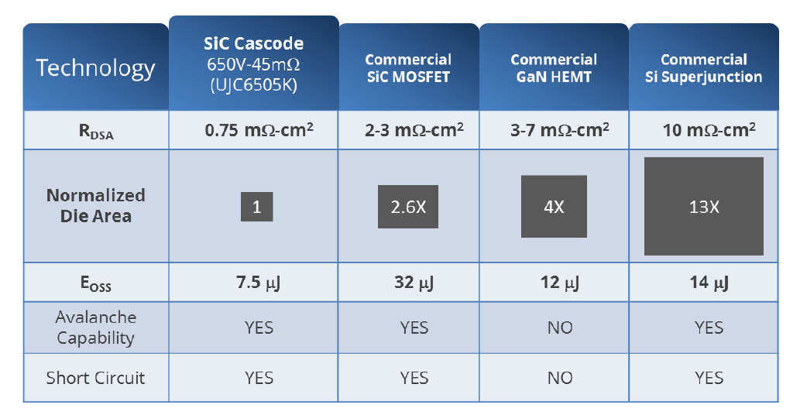
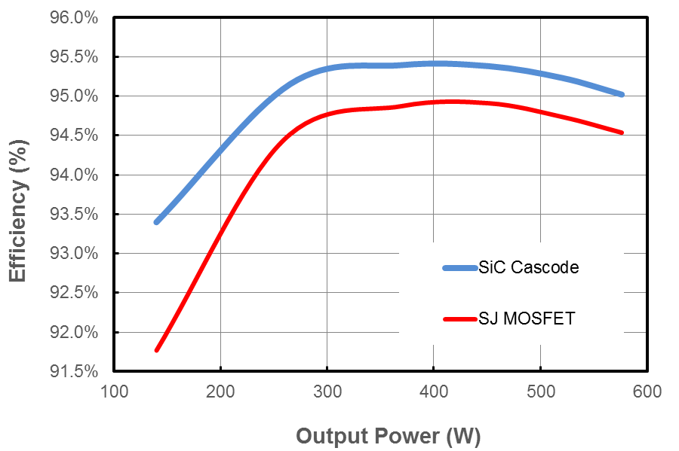
650V FET Comparisons
PFSB Efficiency Vin=400V, Vo=48V, 75kHz

Slide 21
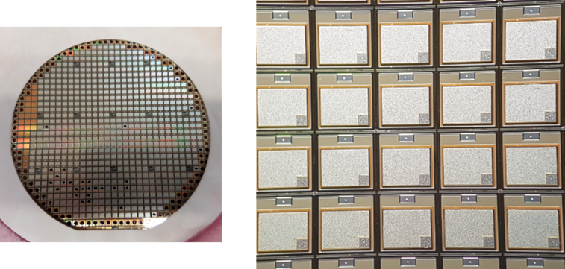
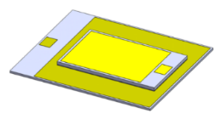
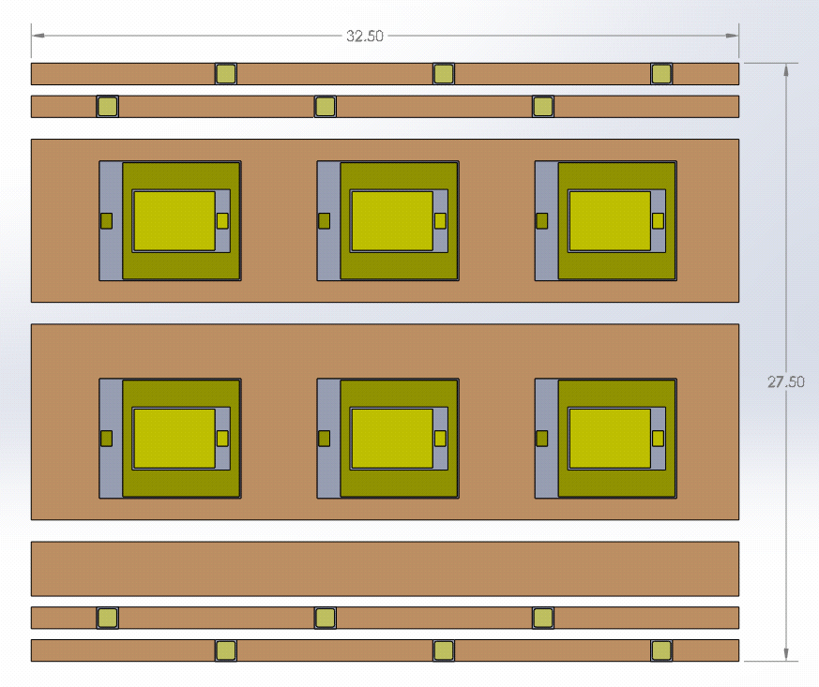
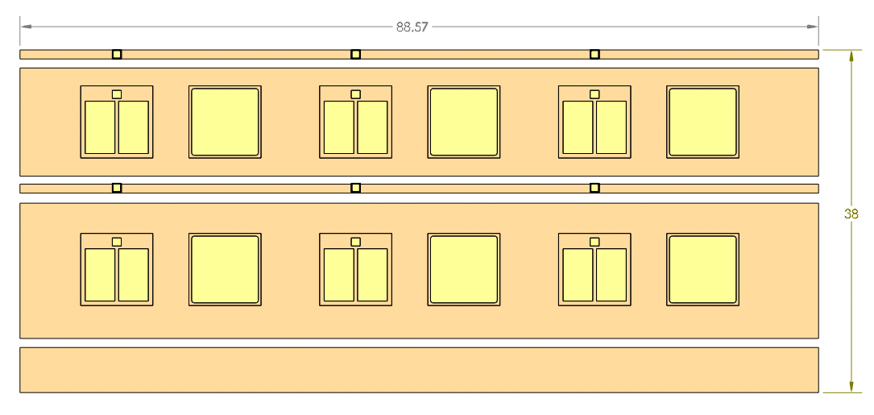
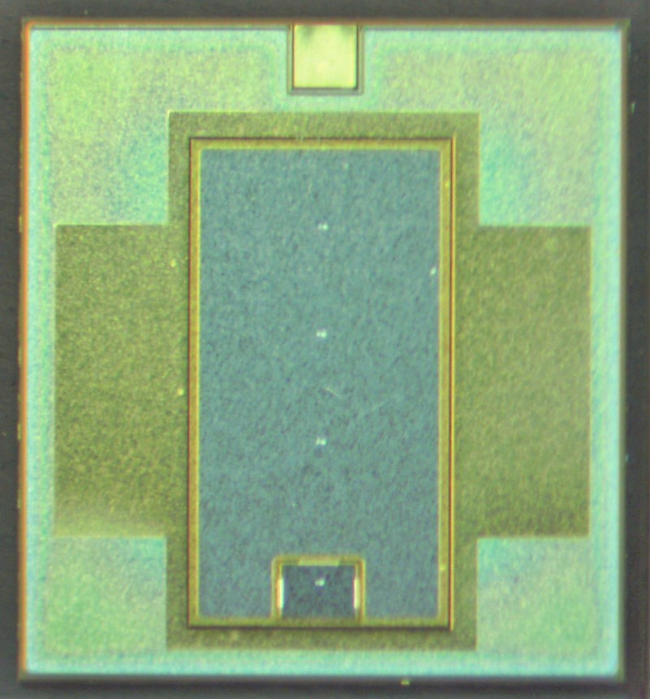
100A, 1200V SiC Cascode Stack Advantage
As the world moves to multilevel architectures, the inside of the module will become even more complex.
UnitedSiC’s Cascode Stack enables simplification through fewer components, creating more space within the highly complex architecture and ultimately displacing the diode.
8mohm, 1200V switch in just 5.5X6.5mm (100A, 1200V)
All the advantages of cascodes
Simplifies module packaging, no antiparallel diodes
Building block for high current modules of all types
HB, FB, 3-PHASE, TNPC, NPC
Promising for EV applications
SiC MOSFET + JBS 1200V
100A X 3
100A Stack 1200V
100A X 3

Slide 22
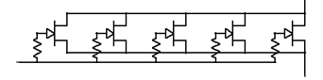
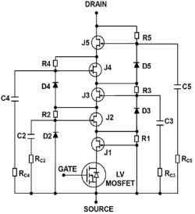
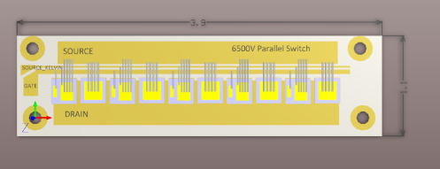
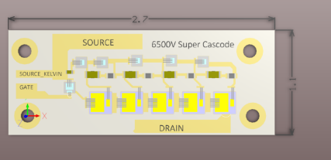
Supercascode: The next generation of devices > 3.3kV
Patented design constructed from Normally On JFETs, providing breakthrough cost and performance
Configuration 1: Traditional
Configuration 2: Supercascode
5 parallel 250 mΩ, 6500 V device N-off
5 series 10 mΩ, 1200 V devices
Use commercial devices with 1.2-1.7kV rating in series and a Si MOSFET for control
Develop and use devices with high voltage rating
Low device voltage rating enables use of commercially available devices
High device voltage rating requires thick epi layer
Low development risk and short development time
Low component / module cost
Thick epi increases R_{DSA,} requiring multiple parallel devices for acceptable efficiency
Thick epi increases device cost, switch development cost and development risk

Slide 23
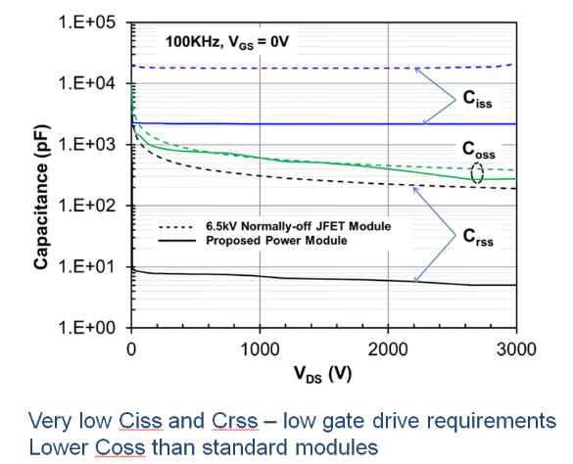
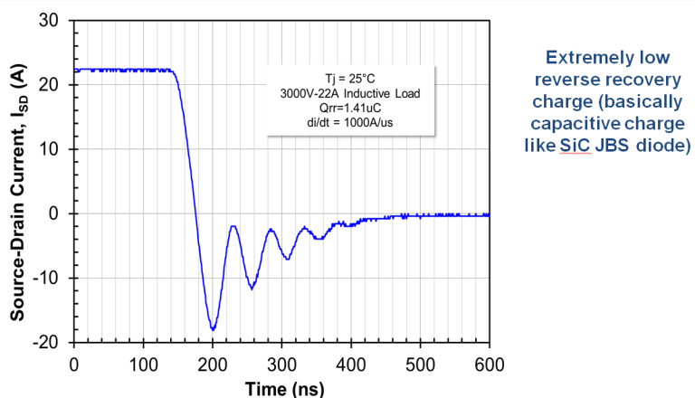
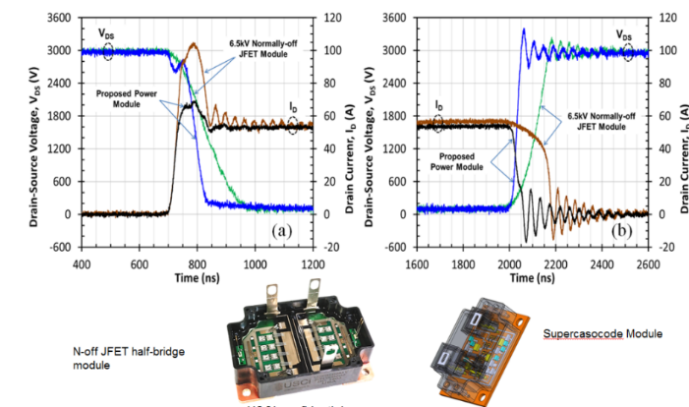
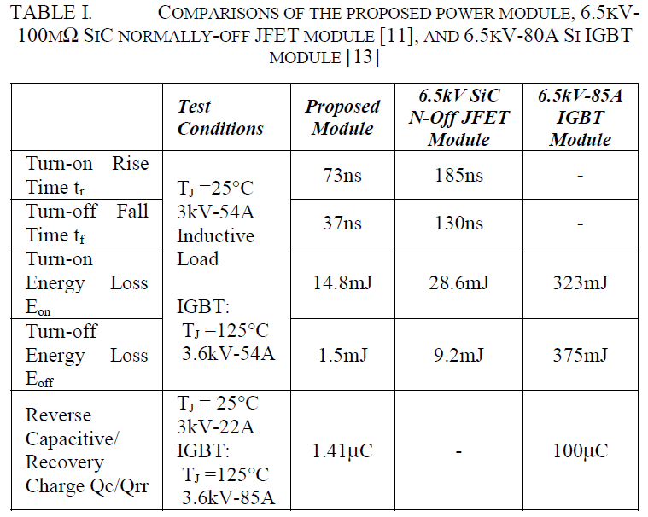

Supercascode Performance
Low Gate Drive Requirements
Extremely Low Reverse Recovery Charge
Extremely low reverse recovery charge (basically capacitive charge like SiC JBS diode)
Very low Ciss and Crss
Lower Coss than standard modules
N-off JFET Half-bridge vs. Supercascode
Datasheet Comparison
Comparisons of the proposed power module, 6.5kV–100mΩ SiC normally-off JFET module and 6.5kV-85A Si IGBT module
N-off JFET half-bridge module
Supercascode module

Slide 24
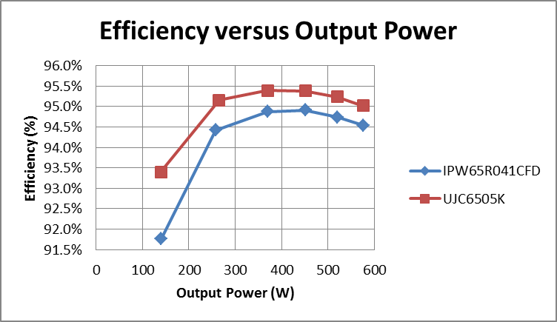
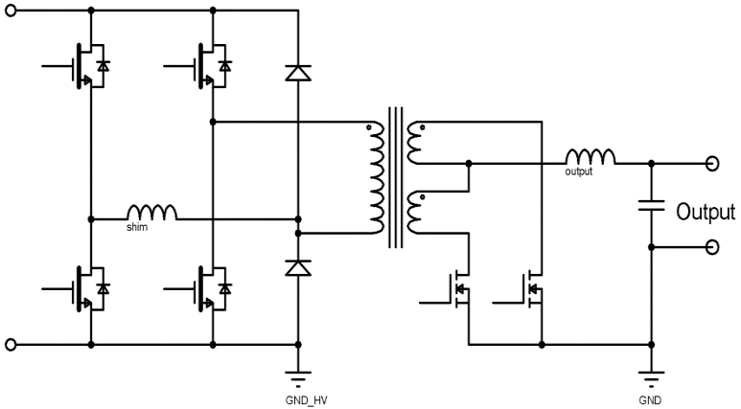
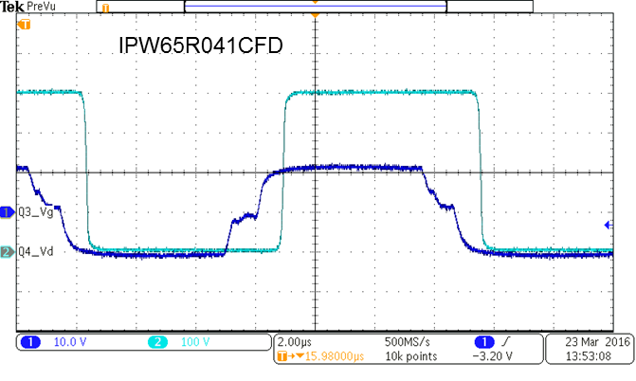
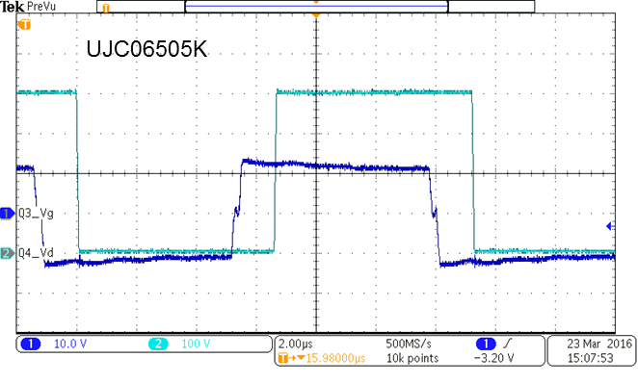
UnitedSiC 650V SiC FETs Surpass Super-Junction
Test results of cascode drop-in replacement of super-junction MOSFET in phase shift full bridge
UJC06505K
MOSFET SRs
Phase shift full bridge (PSFB) circuit with synchronous rectifier (SR) output
V_{ds}
Greatly reduced capacitances = faster switching
V_{gs}

Slide 25
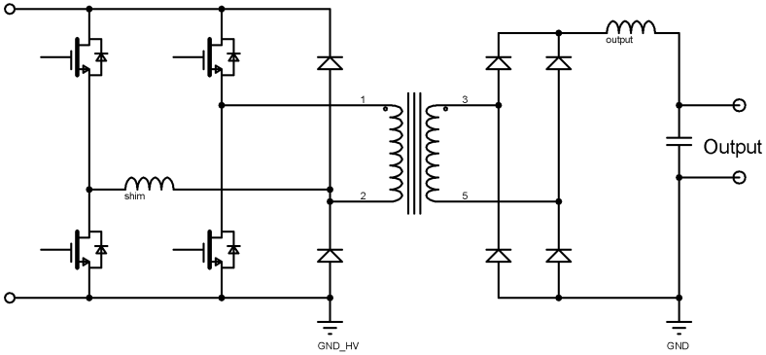
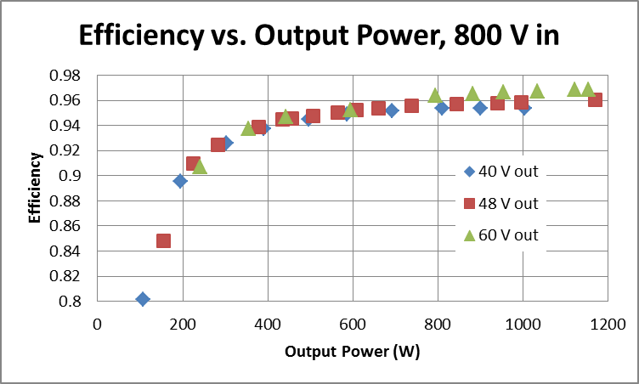
Cascode Enables High Voltage PSFB
USCi 1200 V Cascode:
UJ3C1202KS
UJC1206K
UJC1210T/K
UJC1220T/K
700 to 800 V input
USCi 1200 V Schottky Diode:
UJ3D1202D
UJ2D1205T
USCi 1200 V Schottky Diode:
UJ2D1220K
UJ2D1230K
Combination of low R_{DS(on)}, 1200 V rating, and extremely low capacitances
With high output voltage, a full-bridge Schottky diode rectifier yields lowest loss
Small, 1200 V Schottky clamp diodes arrest ringing →new part UJ3D1202D
Typical application: on or off-board electric vehicle charger

Slide 26
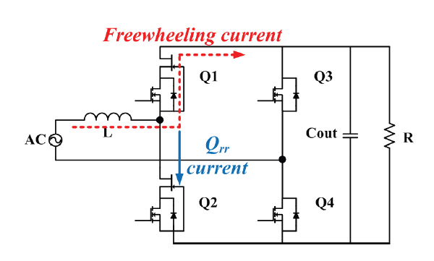
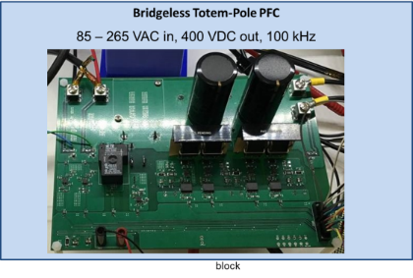


650V cascode – Totem Pole PFC
Uniquely qualified for use in CCM Totem Pole PFC due to excellent Body Diode

Slide 27


Solar Inverter Applications
USCi 1200V Cascode:
UJ3C120150K3S
UJ3C120080K3S
UJ3C120040K3S
UJ3C120150K4S
UJ3C120080K4S
UJ3C120040K4S
Three-level NPC inverter
USCi 650 or 1200V Diode:
UJ3D06520KSD or U32D1220KSD
UJ3D06530TS or U32D1210KS
USCi 650V Cascode:
UJ3C065030K3S, UJ3C065030K4S
UJ3C065080K3S, UJ3C065080K4S
Three-level TNPC inverter
As with an AFE, compact and efficient solar inverters are made possible by low R_{DS(on)} with high voltage rating combined with excellent reverse conduction and recovery characteristic
Low reverse conduction loss eliminates need for bypass diodes, even at high switching frequency
Extremely high efficiency is possible due to very low switching loss
Three-level is “standard” for new solar designs
Enables high input voltages, up to 1700 V
Can use switching algorithm with either NPC or TNPC topology to reduce or eliminate common-mode voltages

Slide 28




TNPC Power blocks with Cascodes 4-cell parallel

Slide 29



Ultra Low RDS Devices – Power Routing
Ultra-small/Ultra-light low resistance high voltage switches
Solid state breakers and power controllers
2X lower Rds than MOSFETs in a given footprint
1.7mohm, 1200V switch in SOT227 footprint
>2X smaller than any SiC MOS alternative
Parallels 6X 8.1mohm Stack cascodes
In development
S
G
25mm
S
D
20mm

Slide 30
Summary
SiC Diodes
Best-in-class performance
Highest currents available
UnitedSiC unmatched with industry leading die sizes
SiC JFET
Best in class devices for specialized protection applications
SiC FETs
Ease of use (Universal 12V/0V or 20V / -5V Gate Drive)
Performance (Low Vf , Qrr Body-diode, switching energies)
Reliability (No SiC Gate oxide, No SiC body diode, 5V Threshold voltage)
No SiC FWD necessary
Technical Support
App Notes, Datasheets and SPICE models available at www.unitedsic.com
Various Eval Boards already available (PSFB, Totem Pole PFC, Flyback, H-Bridge)
Contacts:
J. Christopher Dries – President and CEO – jcdries@unitedsic.com – 732-355-0550

